Slide 1

Tangent Line
Name : Rifa Azad
Id : 2022-1-60-265
Course: MAT 101(14)
CSE department

Slide 2
What is Tangent line?
Tangent line was explained in plain geometry as a line that touches a circle at precisely one point. As shown below,
Tangent line
But what about these figure below?
Those lines seems like tangent lines but will not be regarded as a tangent lines even though the lines has touched the curves at precisely at one point.

Slide 3
So what defines a tangent line?
In geometry, the tangent line to a plane curve at a given point is the straight line that "just touches" the curve at that point.
To have a better understanding,
Let’s assume there is a curve in the xy-plane and has a point A and a different point B. Connecting these two points we get a line AB which is called secant line for the curve at point A.
y
A
B
secant line
x
O

Slide 4
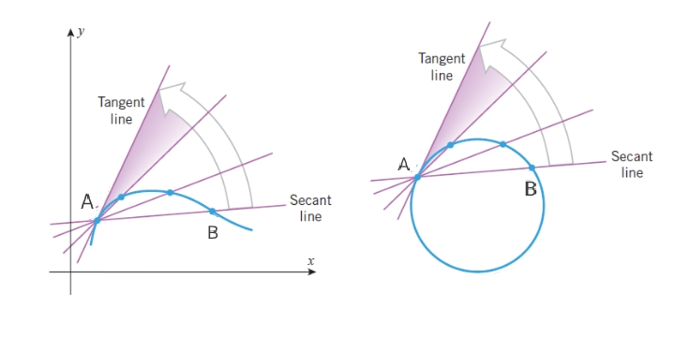
Now, if we move the point B along the curve toward A . When point B will be closest to point A but not on point A then the secant line will rotate toward a limiting position. This new position of the secant line is called tangent line at A. This concept also coincides with the previous concept of tangent line on a circle in plain geometry.
The equation of the tangent line is ,
where m is the slope and
is the coordinate points of the line.

Slide 5
Why tangent line is so important?
The tangent line is important to find the slope of a curve at a particular point on the curve. Following the equation of tangent line,
We know that is 1st derivative of y with respect to x, so tangent line is not important only to get slope of a curve but also for calculus especially for limits and continuity.

